Slide 1
App Trader
Wu-Tang Flan

Slide 2

Context
We have been asked to provide an analysis of where an app marketing company, App Trader, should invest. App Trader’s business preferences are to:
Focus on apps available in both the App Store and the Play Store
Spend prudently on the rights to market, which is tied to the store’s price of the app
Focus on apps with an anticipated long life

Slide 3

Methodology
As analysts, determine the factors which would make an app a good candidate for AppTrader to buy the marketing rights to.
Lucrative genre/category
Wide potential audience, based on content rating
Available in both app stores for similar price
Long expected lifespan, based on reviews
Low price to buy marketing rights, based on app’s in-store price

Slide 4
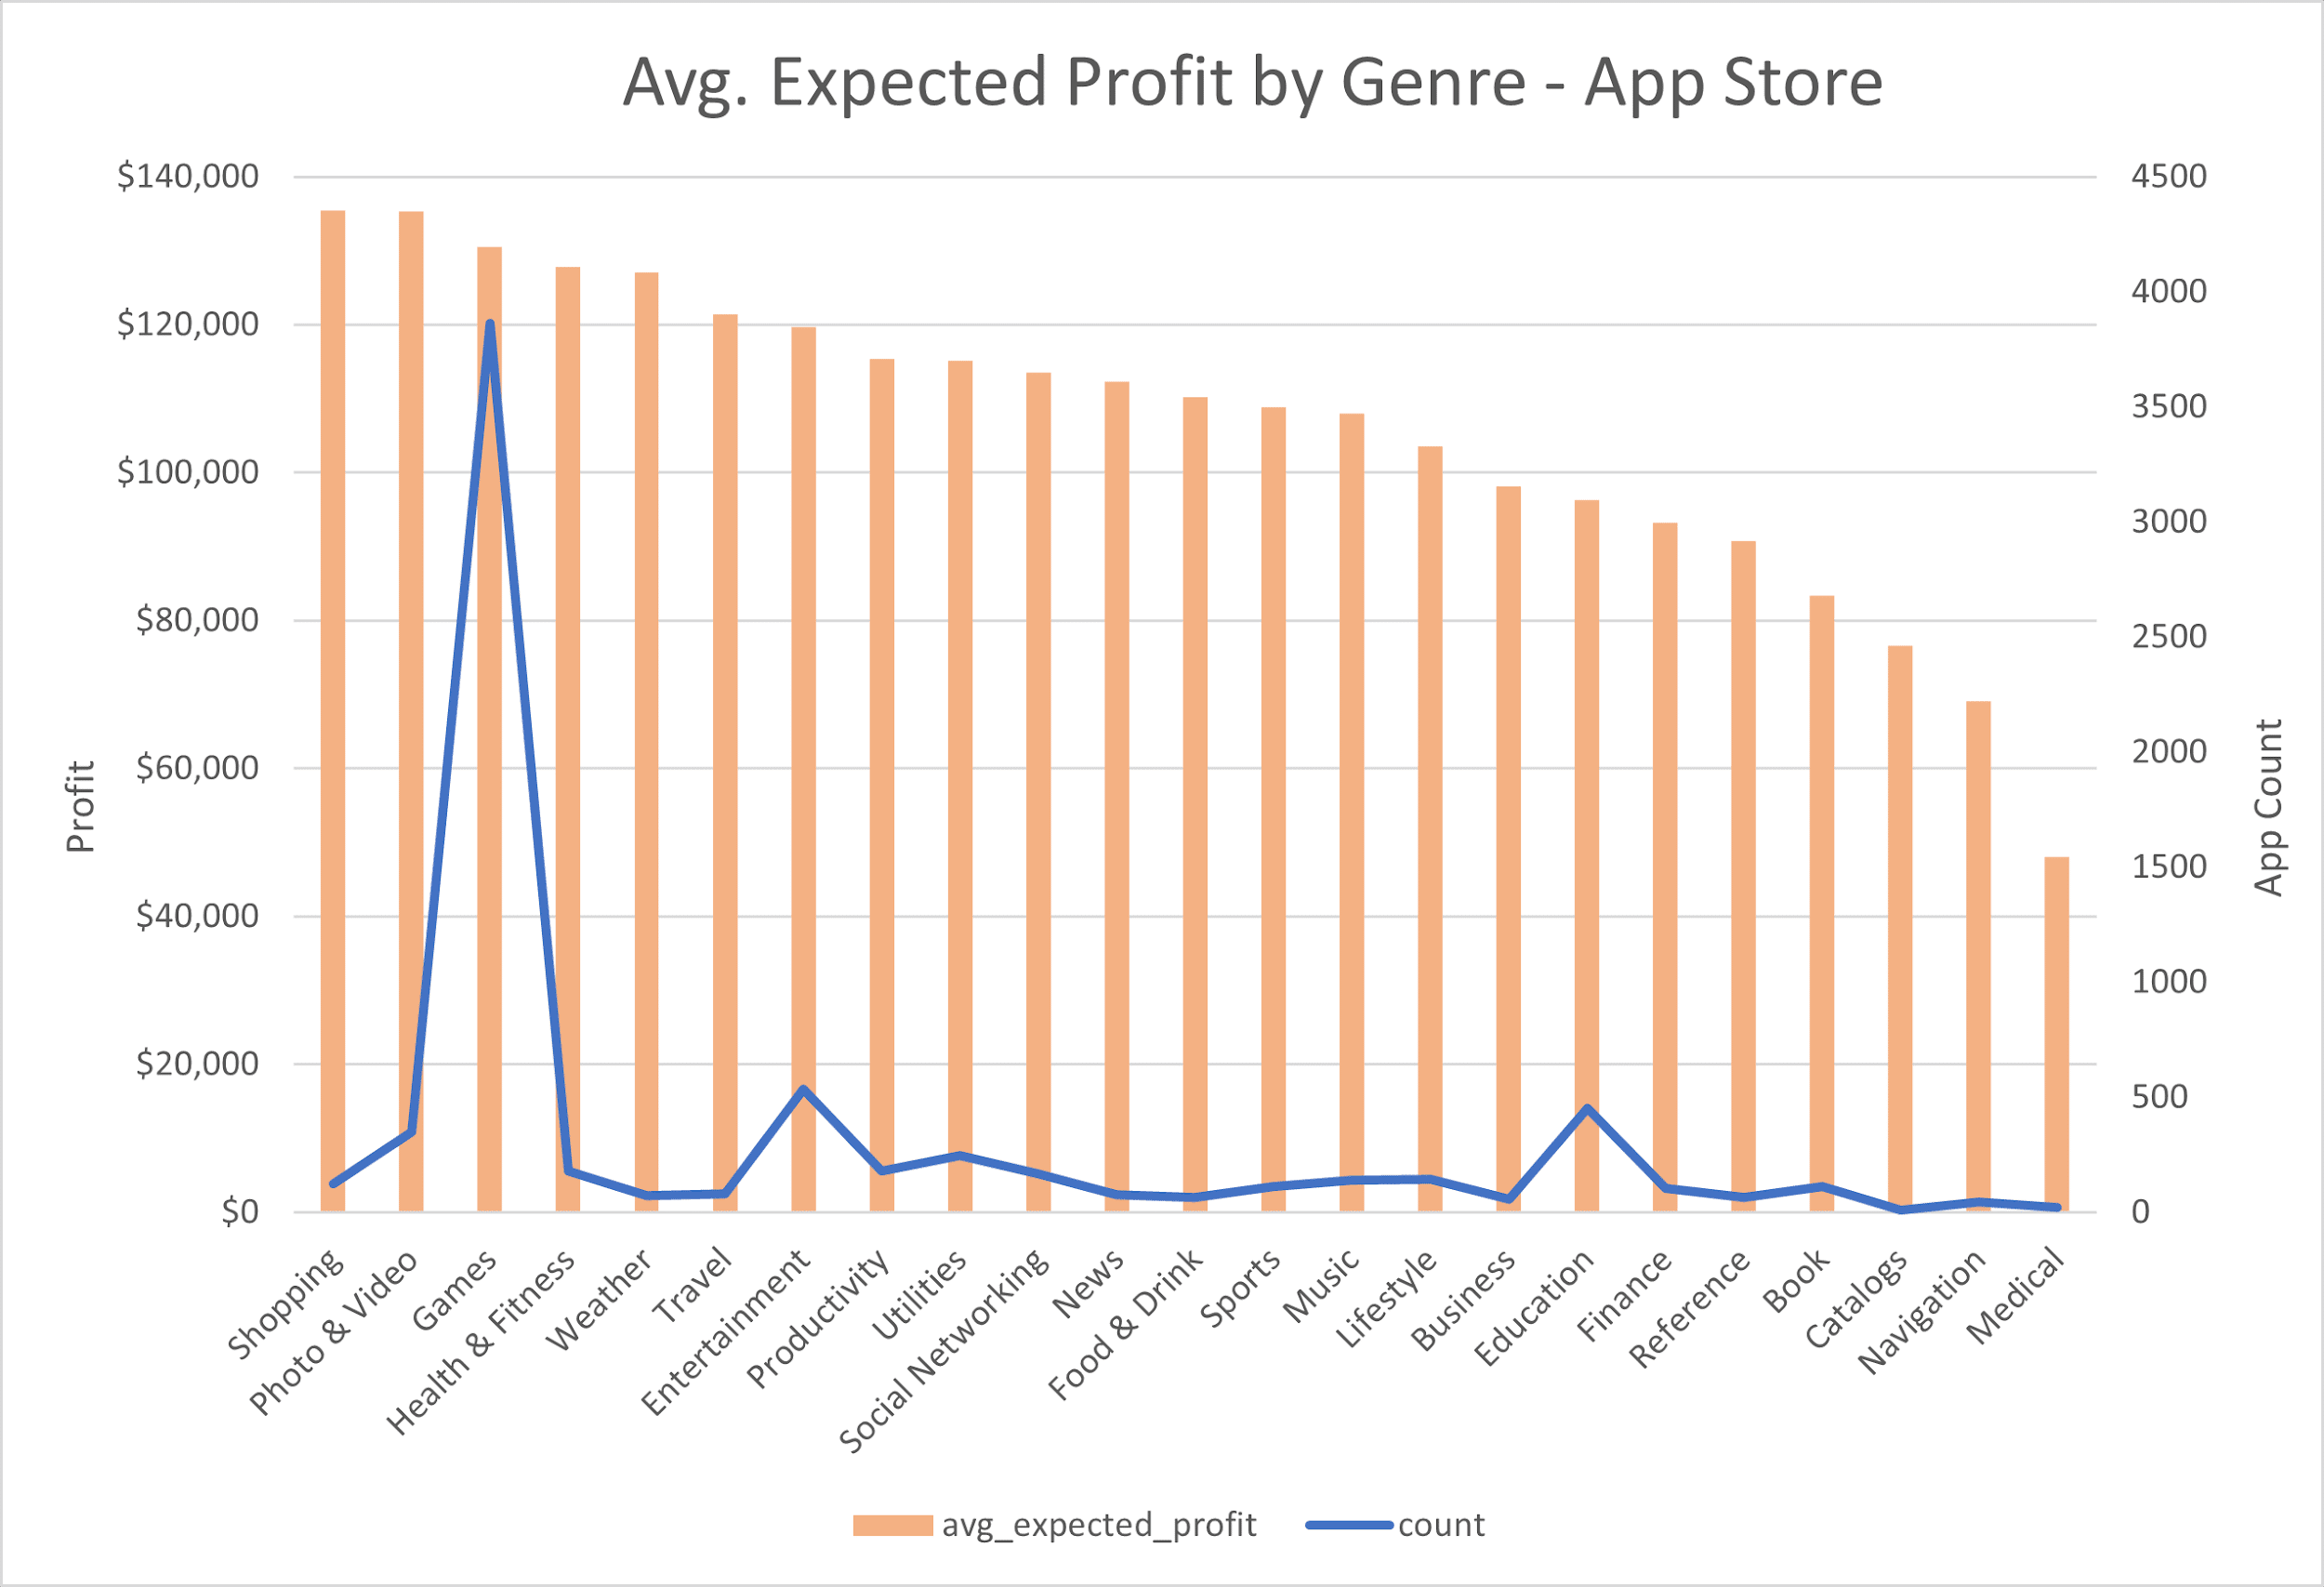
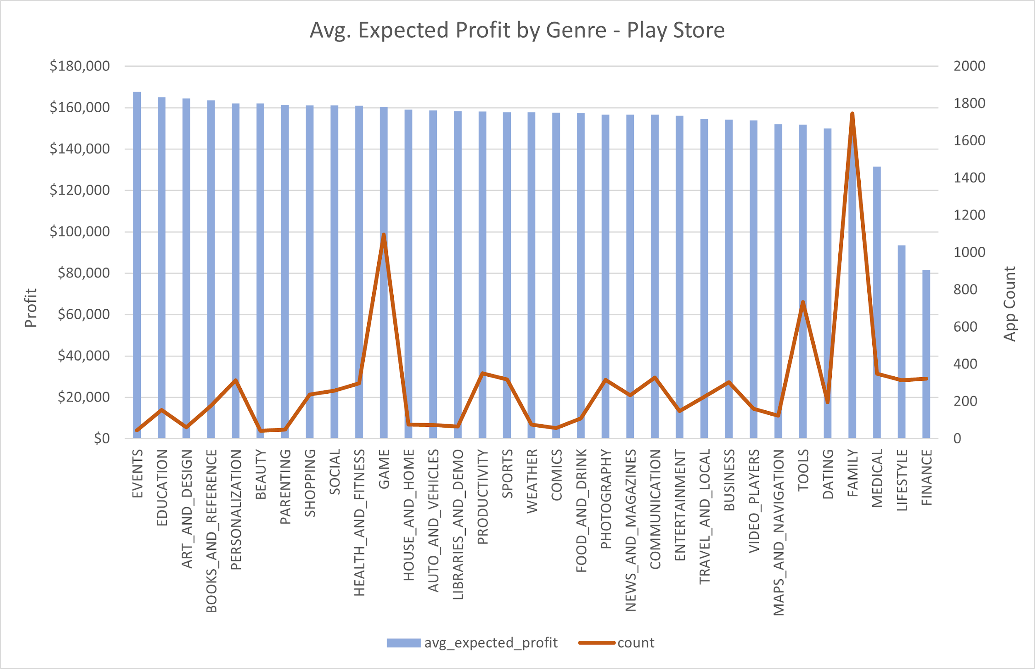
Average Profit by Genre
Notes:
$1500 * (12*(1+2*rating) - 10000
$1500 * (12*(1+2*rating) - 10000*price
Games most profitable
Largest category
In app purchases extra lives, etc
More apps
Addicting

Slide 5
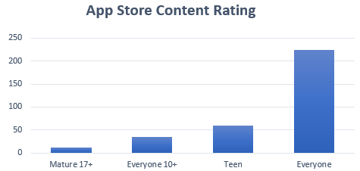
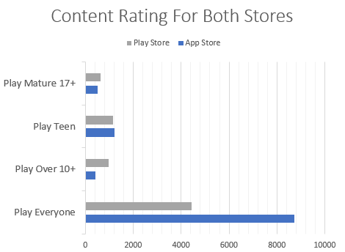
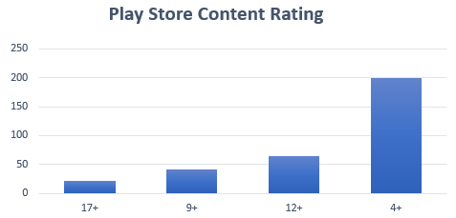
Content Rating

Slide 6
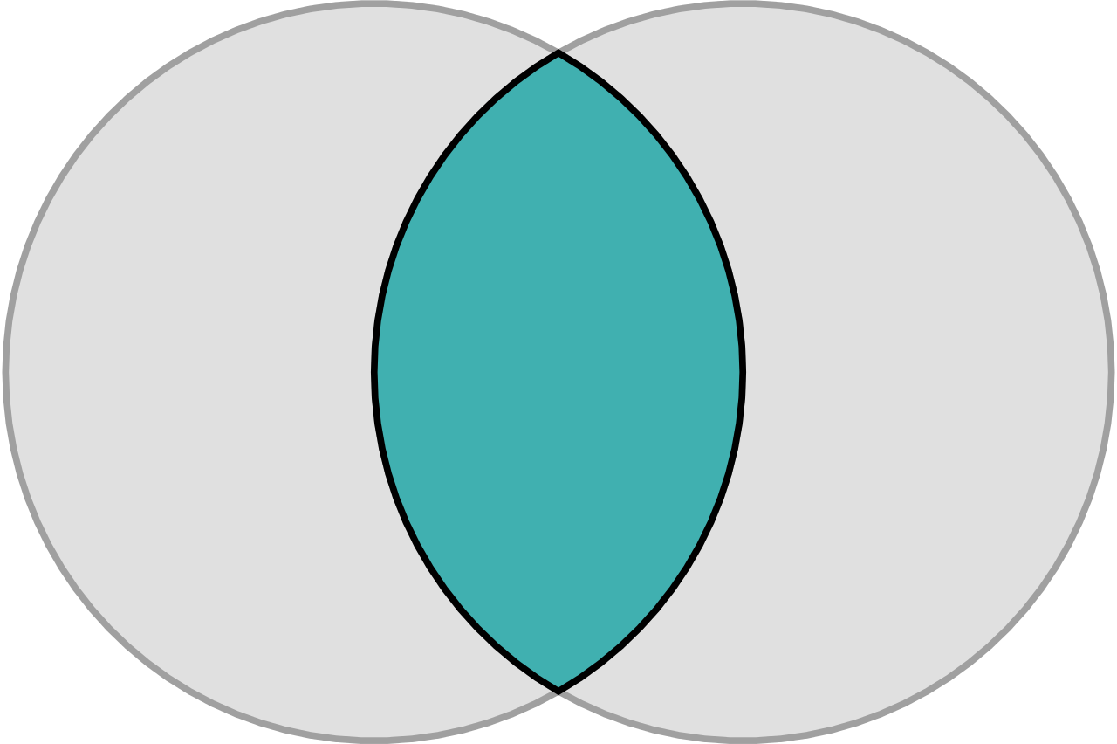
Similar ratings across stores
We assume that apps with a high rating in both stores will ensure its longevity and therefore extend its potential for earning money.
Example apps with rating parity in both stores:
Wish - Shopping Made Fun
My Talking Tom
Trello
Hay Day
(Pewdiepie’s Tuber Simulator)
Toca Kitchen 2
Washington Post Classic
Cooking Fever
Smash Hit
Angry Birds Epic RPG

Slide 7

Top 10 App Considerations
Wu-Tang Flan did a SQL query:
Ordered by:
Average rating for both tables
Total reviews for both tables
App price
Year longevity
How long the app is predicted to survive
Net end_of_longevity_profit
Profit at the end of the predicted app time
Eliminated
Domino’s Pizza due to app only in use while ordering
Cytus -Has a charge which reduces profit
The EO Bar - has low total reviews and high price ($6.99)
Added
Clash of Clans
Subway Surfers
Candy Crush Saga

Slide 8

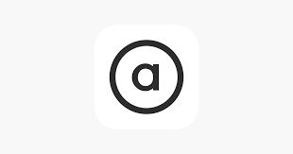

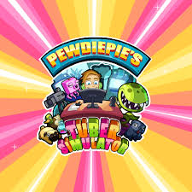

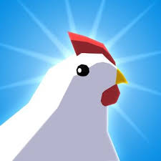
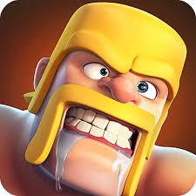
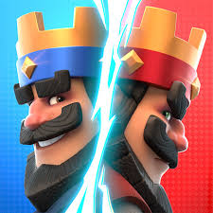
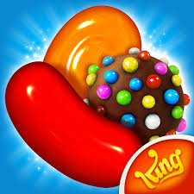
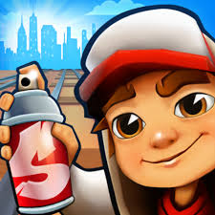
Top Ten Apps
Geometry Dash Lite 6. WhatsApp Messenger
PewDiePie’s Tuber Simulator 7. Clash of Clans
Egg,Inc. 8. Subway Surfers
ASOS 9. Candy Crush Saga
Instagram 10. Clash Royale

